Slide 1
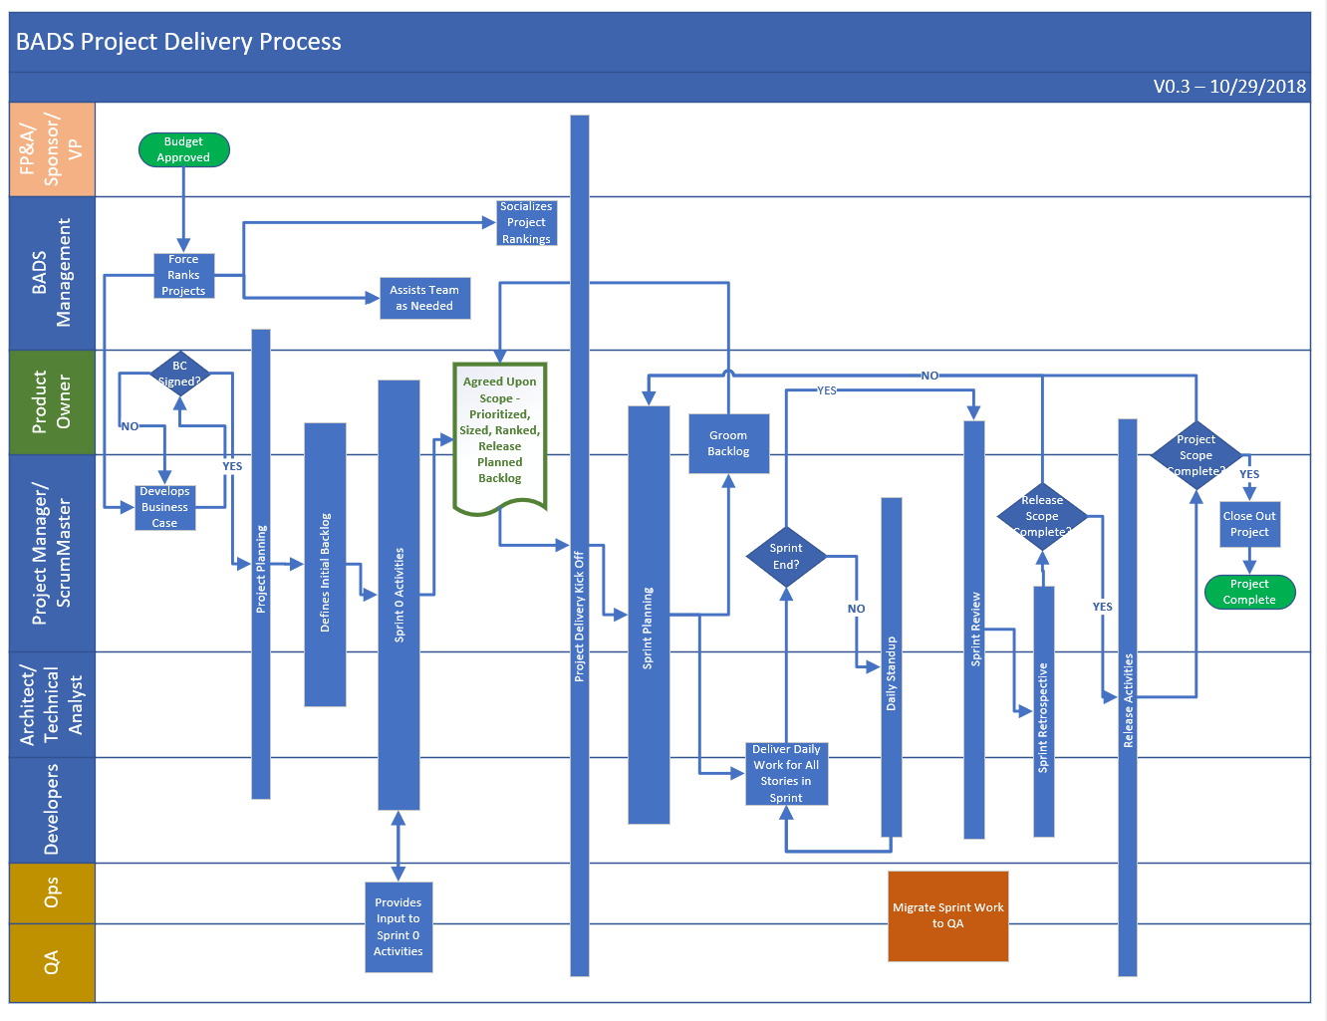

Slide 2
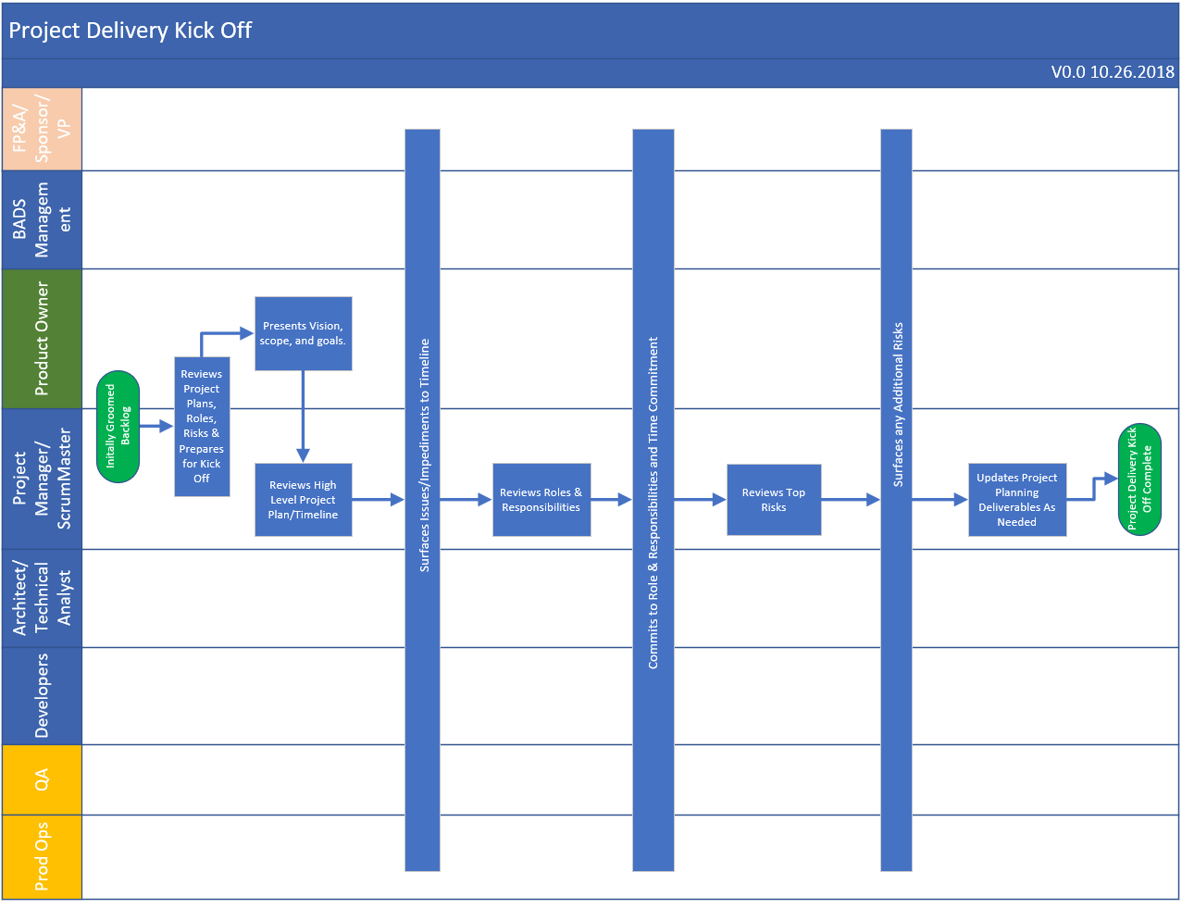

Slide 3
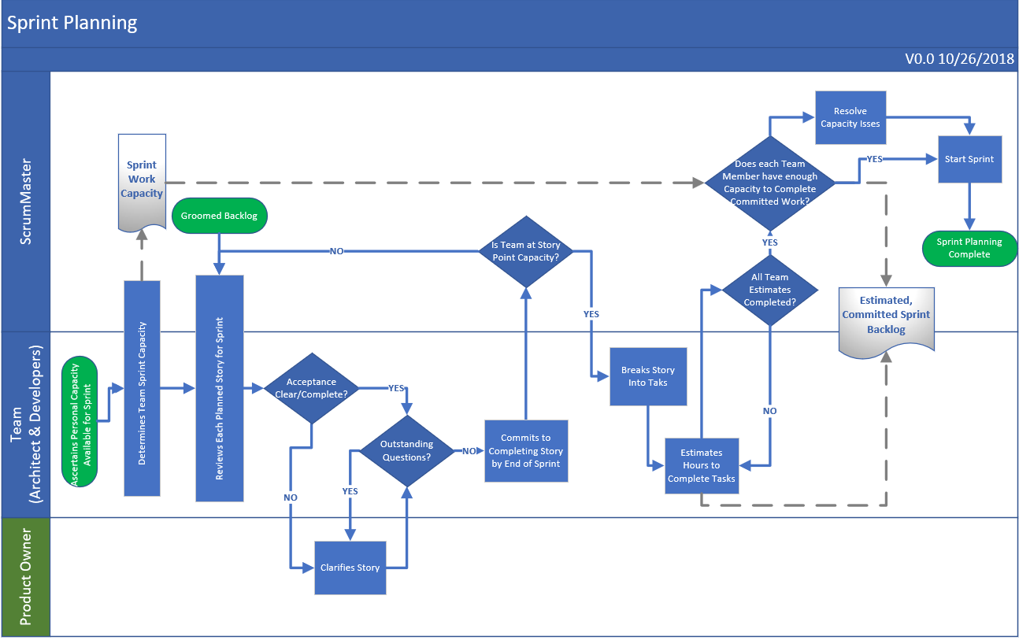

Slide 4
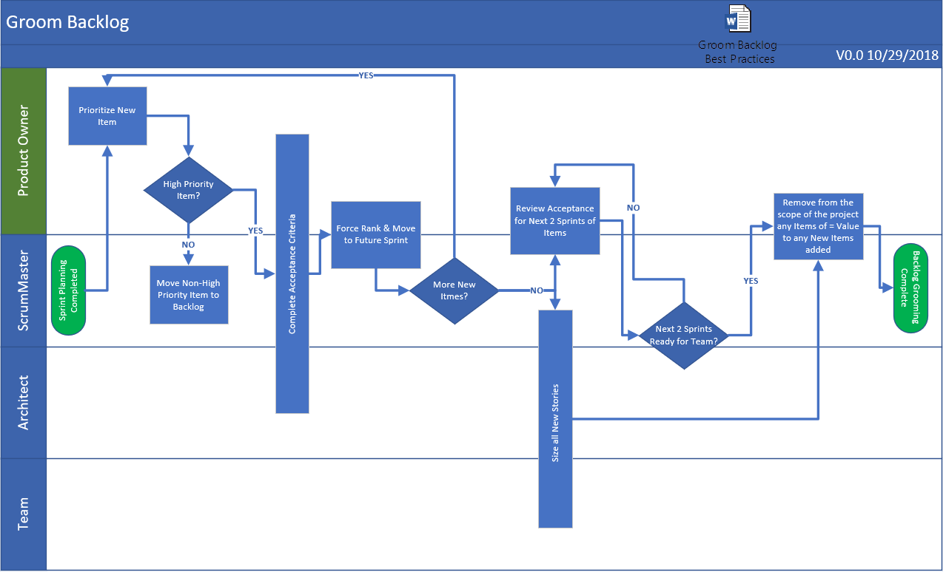

Slide 5
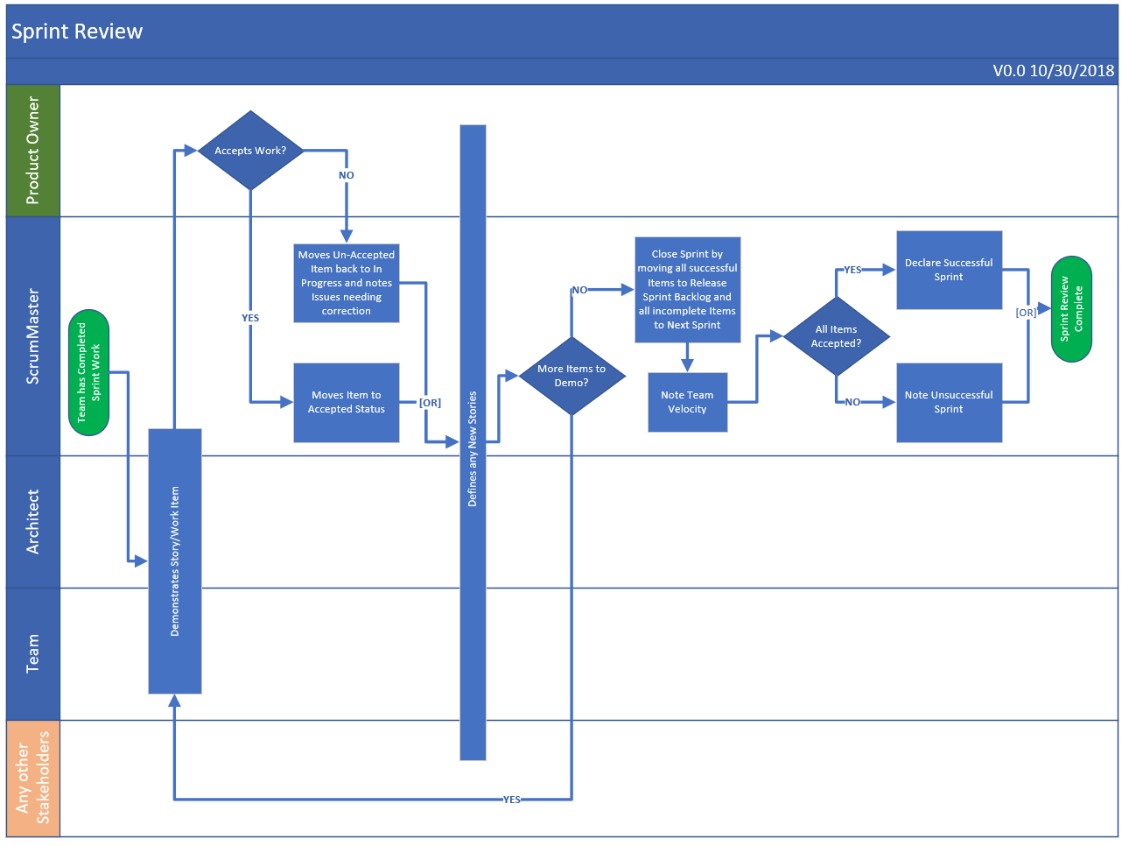

Slide 6
Review Tools/Best Practices
Project Planning Deliverables:
Roles & Responsibilities
High Level Project Timeline?
Do we already do this?
Risk Assessment
Define Initial Backlog:
Prioritization vs. Force Rank
MoSCoW for Stories?
Sprint 0 Activities:
Story Point Reference
Project Scope Agreement?
Release Planned Backlog
Release Burndown Plan?
Other
Time Tracking in DevOps

